Slide 1


MALIGNANT COMMENTS CLASSIFICATION
PRESENTED BY:
ABHIJIT SARKAR

Slide 2


INDEX
Overview
Problem Statement
Problem Understanding
What is Malignant Comment Classification?
Importance of Malignant Comment Classification?
Exploratory data analysis
Visualizations
Analysis
Data Cleaning Steps
Model Building
Hyper Parameter Tuning
Saving model & predictions for Best Model
Conclusion and Test Prediction.

Slide 3

OVER VIEW FOR PREDICTION
In this Presentation we will be looking on the :
How to analyze the dataset of Malignant Comment Classifier.
What are the EDA steps in cleaning the dataset.
Overall analysis on the problem.
Model building from the train dataset.
Predicting Loan Approval for customer.

Slide 4
PROBLEM STATEMENT
There has been a remarkable increase in the cases of cyberbullying and trolls on various social media platforms. Many celebrities and influences are facing backlashes from people and have to come across hateful and offensive comments. This can take a toll on anyone and affect them mentally leading to depression, mental illness, self-hatred and suicidal thoughts. Internet comments are bastions of hatred and vitriol. While online anonymity has provided a new outlet for aggression and hate speech, machine learning can be used to fight it. The problem we sought to solve was the tagging of internet comments that are aggressive towards other users.
This means that insults to third parties such as celebrities will be tagged as unoffensive, but “u are an idiot” is clearly offensive.
THIS PROJECT CONTAINS TWO PHASE:
Train Data SET
Test Data SET

Slide 5
UNDERSTANDING PROBLEM
ITEM 1
ITEM 2
MOTIVATION BEHIND
The proliferation of social media enables people to express their opinions widely online. However, at the same time, this has resulted in the emergence of conflict and hate, making online environments uninviting for users. Although researchers have found that hate is a problem across multiple platforms, there is a lack of models for online hate detection.
Online hate, described as abusive language, aggression, cyberbullying, hatefulness and many others has been identified as a major threat on online social media platforms. Social media platforms are the most prominent grounds for such toxic behaviour.
There has been a remarkable increase in the cases of cyberbullying and trolls on various social media platforms. Many celebrities and influences are facing backlashes from people and have to come across hateful and offensive comments. This can take a toll on anyone and affect them mentally leading to depression, mental illness, self-hatred and suicidal thoughts.
Internet comments are bastions of hatred and vitriol. While online anonymity has provided a new outlet for aggression and hate speech, machine learning can be used to fight it. The problem we sought to solve was the tagging of internet comments that are aggressive towards other users. This means that insults to third parties such as celebrities will be tagged as unoffensive, but “u are an idiot” is clearly offensive.
Our goal is to build a prototype of online hate and abuse comment classifier which can used to classify hate and offensive comments so that it can be controlled and restricted from spreading hatred and cyberbullying.

Slide 6


WHAT IS MALIGNANT COMMENTS CLASSIFICATION?:
The goal of this project is to create a safer environment online. By detecting toxic comments on social media, they can be easily Identified and those comments in long run can be detected and detained removed.
In the long term, this would allow people to better connect with each other in this increasingly digital world.

Slide 7

What is the importance of Malignant Comment Classification ?
Online hate, described as abusive language, aggression, cyberbullying, hatefulness and many others has been identified as a major threat on online social media platforms. Social media platforms are the most prominent grounds for such toxic behavior.
There has been a remarkable increase in the cases of cyberbullying and trolls on various social media platforms. Many celebrities and influences are facing backlashes from people and have to come across hateful and offensive comments.
This can take a toll on anyone and affect them mentally leading to depression, mental illness, self-hatred and suicidal thoughts.
Internet comments are bastions of hatred and vitriol. While online anonymity has provided a new outlet for aggression and hate speech, machine learning can be used to fight it.

Slide 8

EXPLORATORY DATA ANALYSIS :
As a first step I have imported required basic libraries along with natural language processing libraries, and imported both the train and test data set which were in csv format.
Then I did all the statistical analysis of both the data set and checked shape, n uniqueness (unique value) each column contains, data types, value counts ,size .
While checking the info of the datasets I found some columns that one useless columns which contains numbers, Hence dropped those columns with their rows and it won’t add much to target variable.
Then while looking into the value counts I found some columns will null duplicated rows(in both the data set).
Null values were checked and found no null values, Hence missing percentage visualization were performed on null values.

Slide 9
EXPLORATORY DATA ANALYSIS :
Feature Engineering were performed to give a comment rows.
Graph were plotted against the independent variables, univariate analysis along with bi variate analysis were done on category and numerical columns and observation is noted.
Bi-variate analysis was done with different columns using Catplot and count plot and hist plot observations are noted.
Analysis were performed on the basis of ['malignant', 'rude', 'abuse', 'loathe', 'highly malignant’ ] total counts and graph were drawn.
Multi-variate graph were drawn to check the analysis followed by Descriptive and Correlation graph were drawn.

Slide 10
EXPLORATORY DATA ANALYSIS :
Data Cleansing was performed, text data were converted to lower for similar identity and un-wanted symbols were removed from data set.
Toxic words were determined from comments with help of word clouds.
Pie graph was drawn to find the contents, Maximum were Malignant followed by others.
Stop words was being used with additional words were added to stop words for easy classification.
Lemmatization was applied on both the train and test dataset data set.
Scaling Technique was performed using TF (Term Frequency)-IDF(Inverse Document Frequency) was used to bring the data under a single scale.

Slide 11
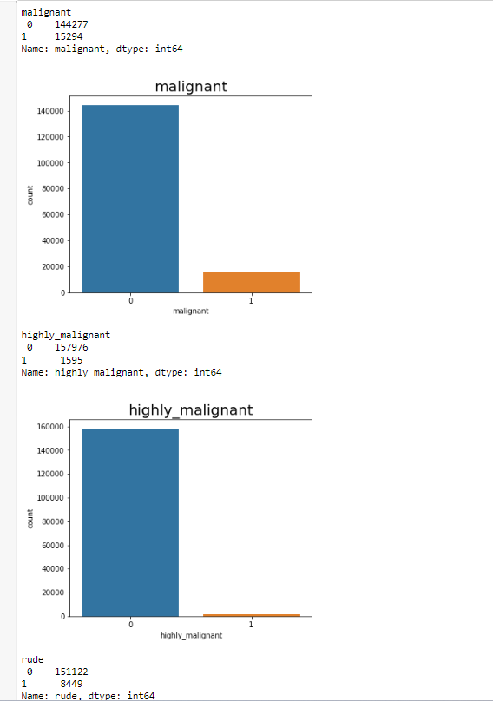
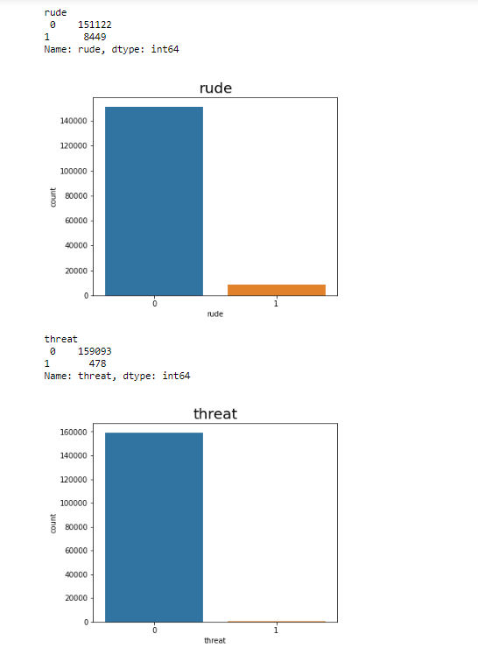
FEW VISUALIZATION

Slide 12
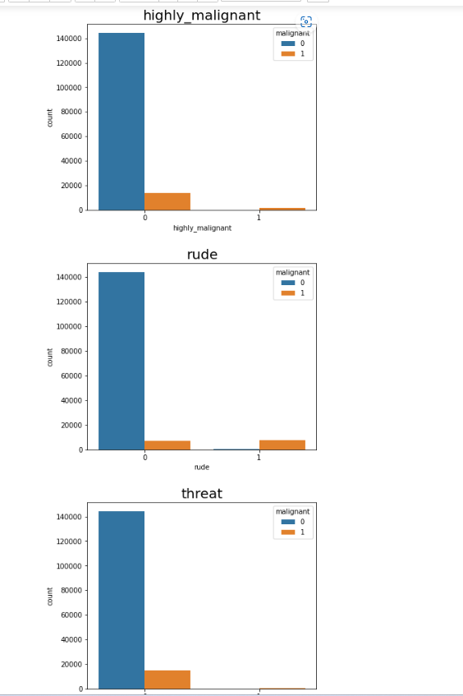
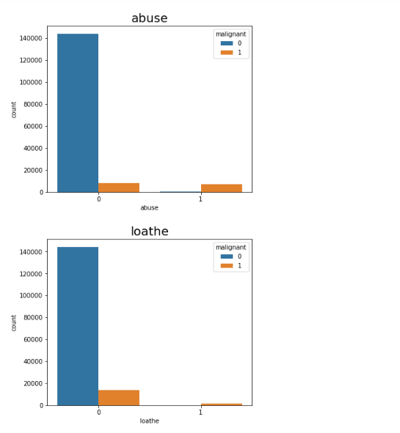
FEW VISUALIZATION

Slide 13
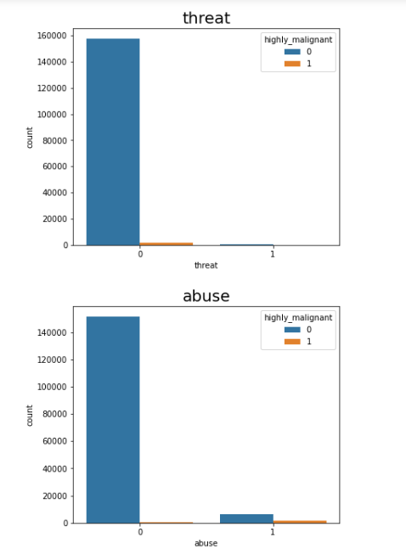
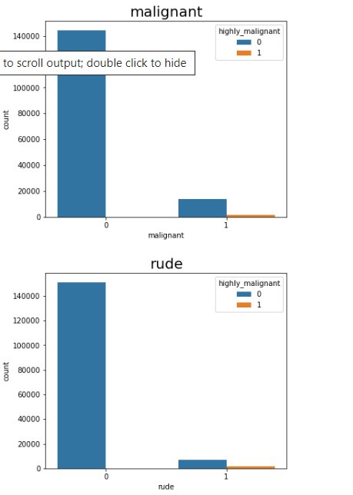
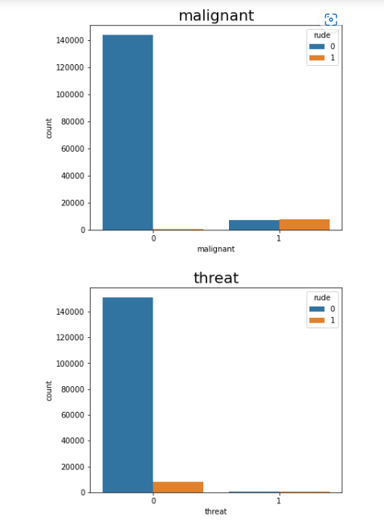
FEW VISUALIZATION

Slide 14
Observation:
- Column malignant shows 1,44,277 are non malignant and 15294 is malignant.
- Highly malignant column shows 1,57,976 are non malignant and 1595 is highly malignant
- Rude column shows 151122 are not rude where as 8449 are rude
- Threat column shows 159093 are not a threat but 478 shows threat
- Abuse column shows 151694 are not a abuse and 7877 shows abuse
- Loathe column shows 158166 are not a loathe and 1405 shows loath

Slide 15
Observation
Non-Highly Malignant , Rude , Non-threat , Non-abuse , Non-loathe are highly malignant.
- Maximum malignant, rude are not highly malignant.
- Maximum non-threat , non-lathe , non-abuse Column shows high malignant.
- Maximum malignant are rude.
- Maximum non threat are rude.
- Maximum abuse are rude.
- Maximum non-loathe are rude.
- Maximum non highly-malignant are rude.
- Maximum malignant , rude, abuse, highly malignant comment showing low threat.
- Non rude , loathe , highly malignant column shows they are a possible threat.

Slide 16
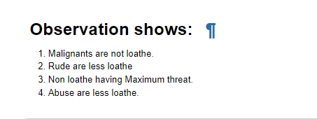
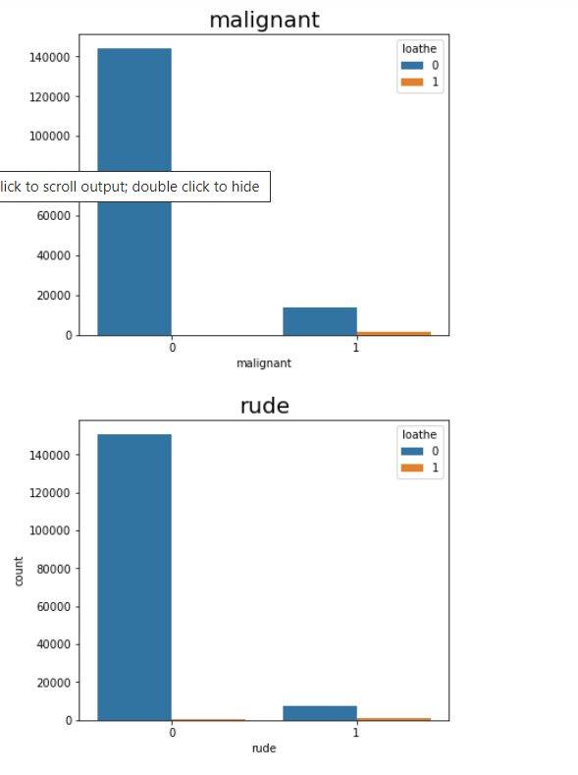
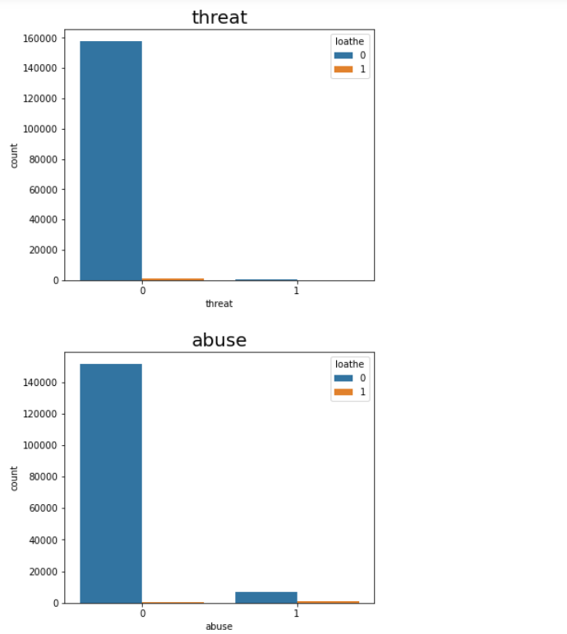

Slide 17

DATA ANALYSIS:
I have used cat plot and count plot to show the relationship between numerical variable.
Other than these, I used Word Cloud to see the foul words. In each columns and found maximum contains of those words within.
I have used NLTK library for Natural Language processing. The other than key was used while removing all the abnormal symbols from target variable.
I found the contains of malignant, highly malignant, rude, threat , abuse, loathe comments distribution with the help of Pie chart. An Extra bar graph was also drawn to show the distribution
Stop words was also used with more feeder words on this library to make the system more ready for classification.
Lemmatization was used to
TF-IDF(Term Frequency-Inverse Document Frequency) was used for vectorization.

Slide 18

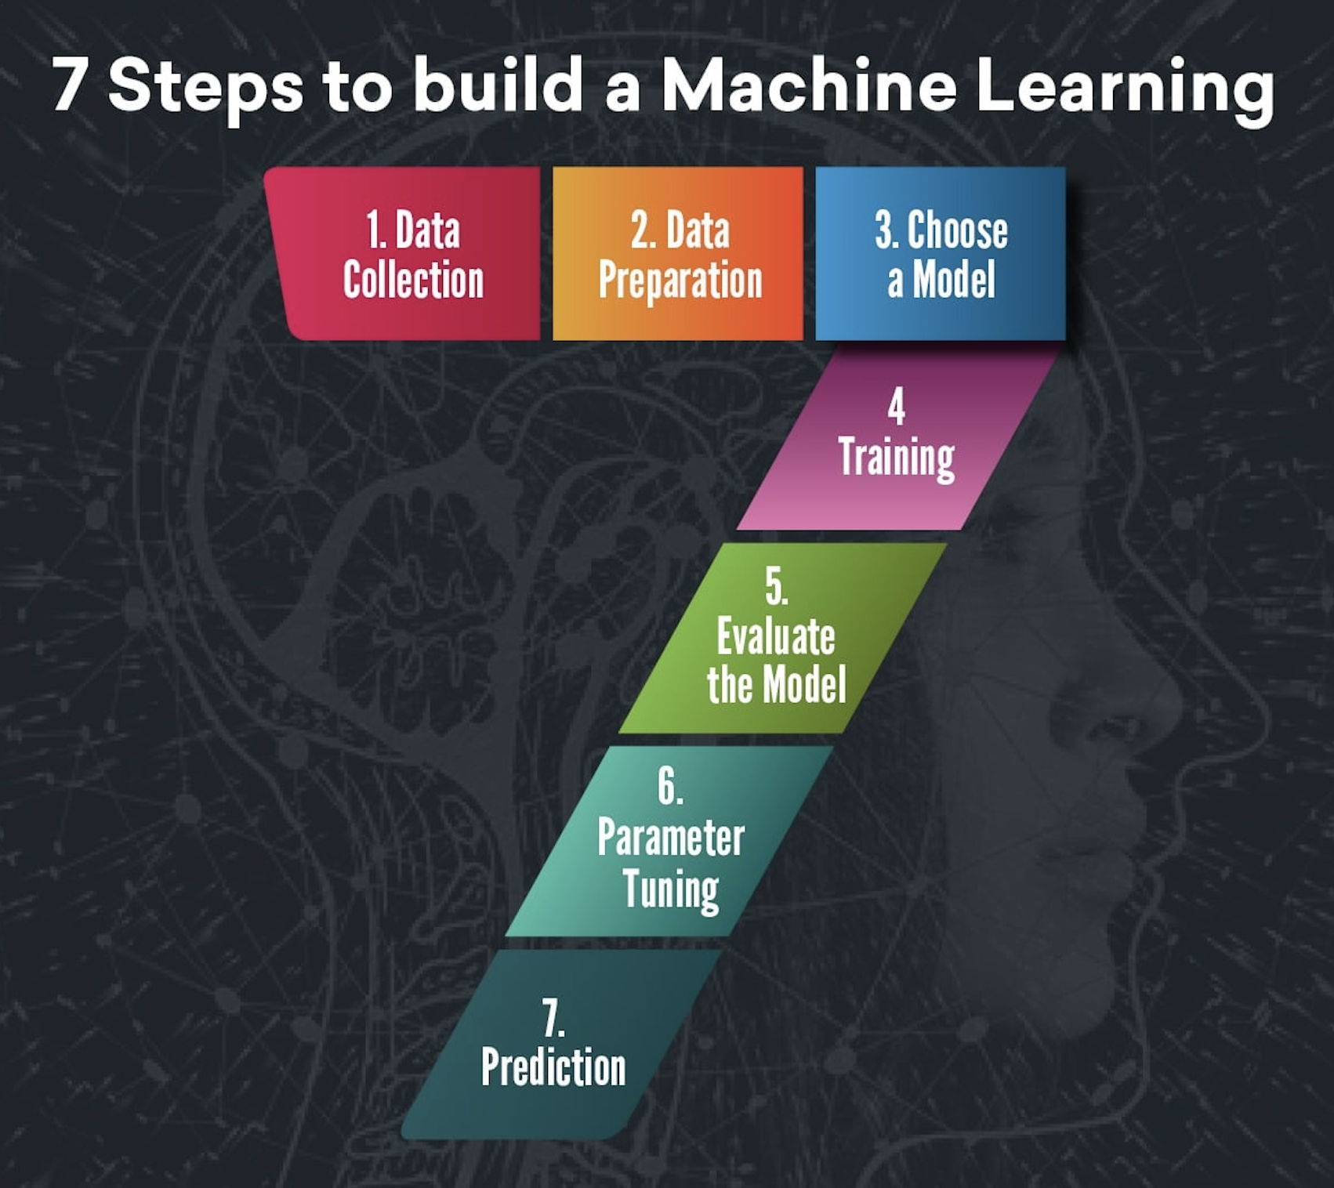
STEPS INVOLVED
Since Label was my target and it was a categorical column so this particular problem was Logistic regression problem. And I have used all Classification algorithms to build my model.
By looking into the difference of accuracy score, f1 score and cross validation score I found Random Forest Classifier as a best model with least difference other Classifier was best too..
Also to get the best model I have to run through multiple models and to avoid the confusion of overfitting we have go through cross validation.

Slide 19
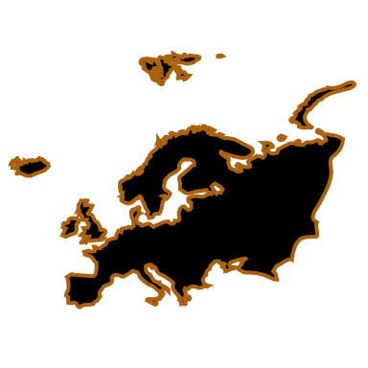
ALGORITHMS I HAVE USED IN MY PROJECT:
Logistic Regression
Decision Tree Classifier.
KNeighbors Classifier.
XGBoost Classifier
Extra Trees Classifier
Random Forest Classifier
Ada Boost Classifier
Gradient Boosting Classifier

Slide 20
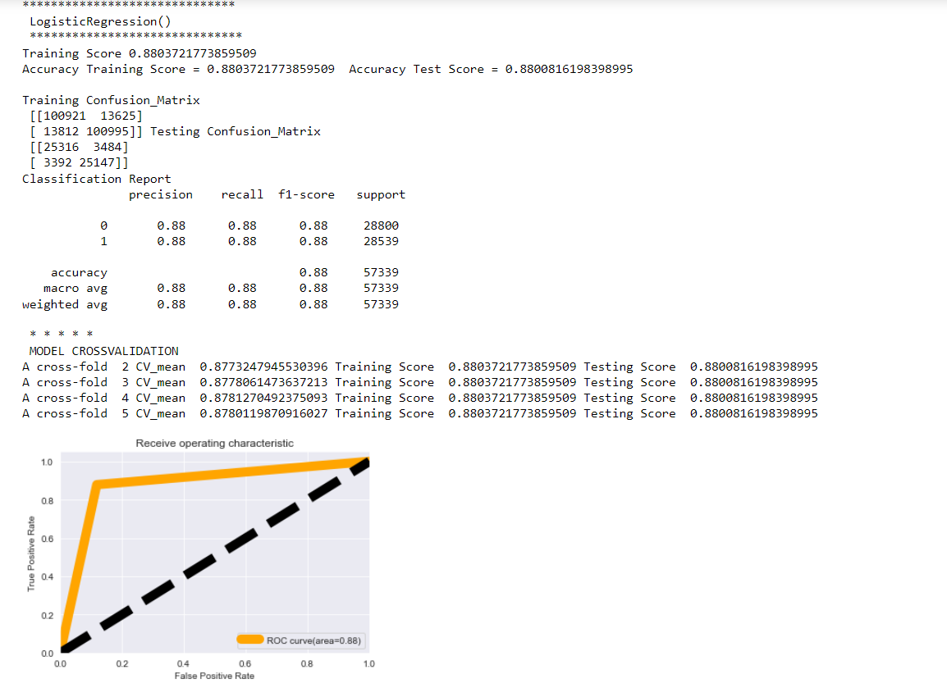
DIFFERENT MODELS WITH THEIR PERFORMANCE:
Logistic Regression

Slide 21
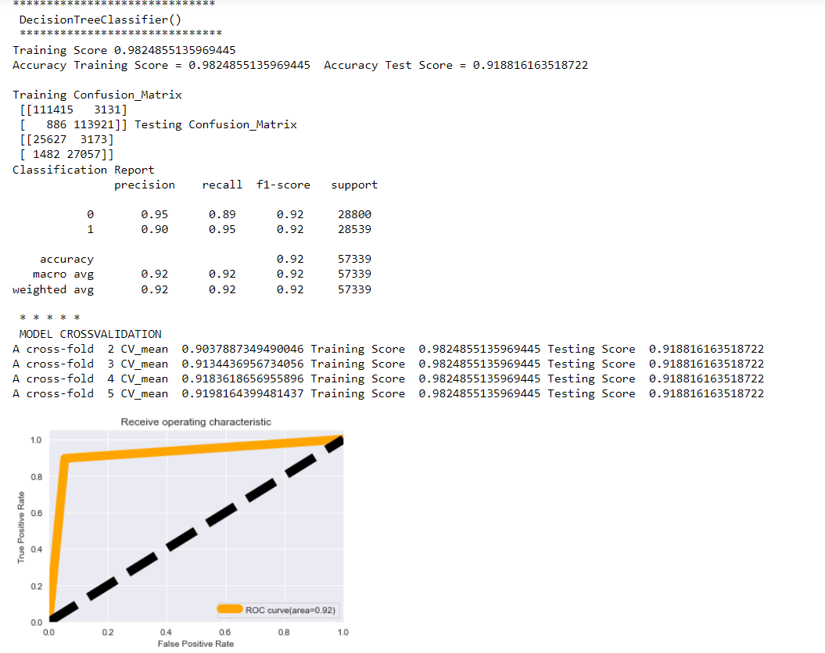
DIFFERENT MODELS WITH THEIR PERFORMANCE:
Decision Tree

Slide 22
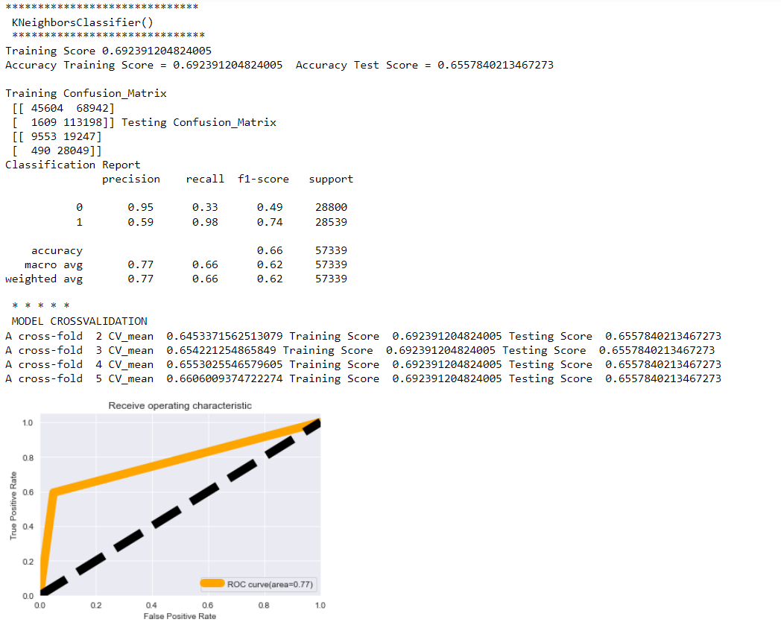
ALGORITHMS I HAVE USED IN MY PROJECT:
KNeighbors Classifier

Slide 23
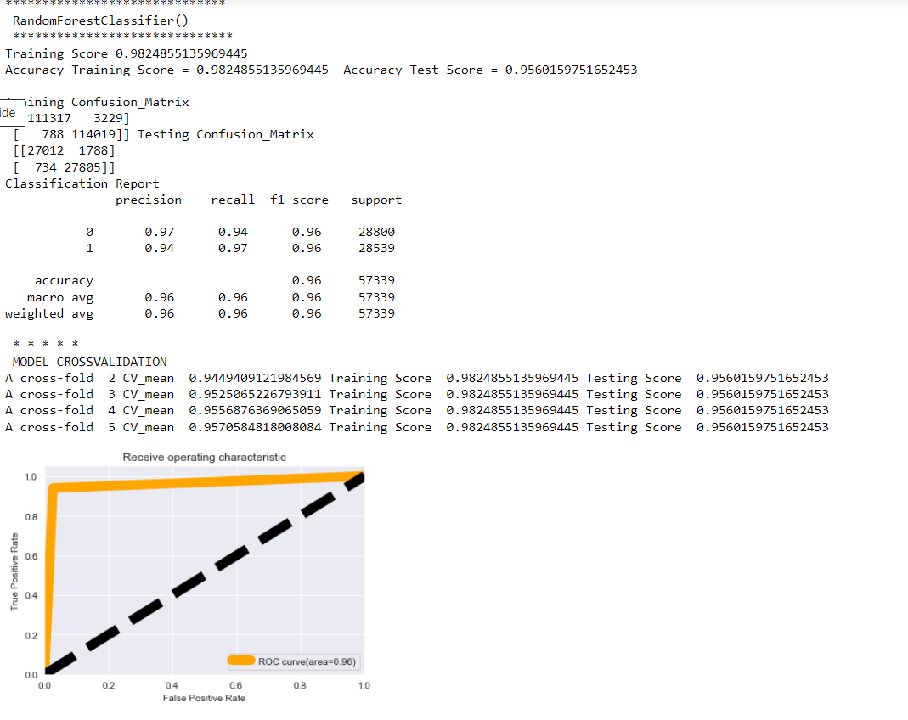
ALGORITHMS I HAVE USED IN PROJECT:
Random Forest Classifier

Slide 24
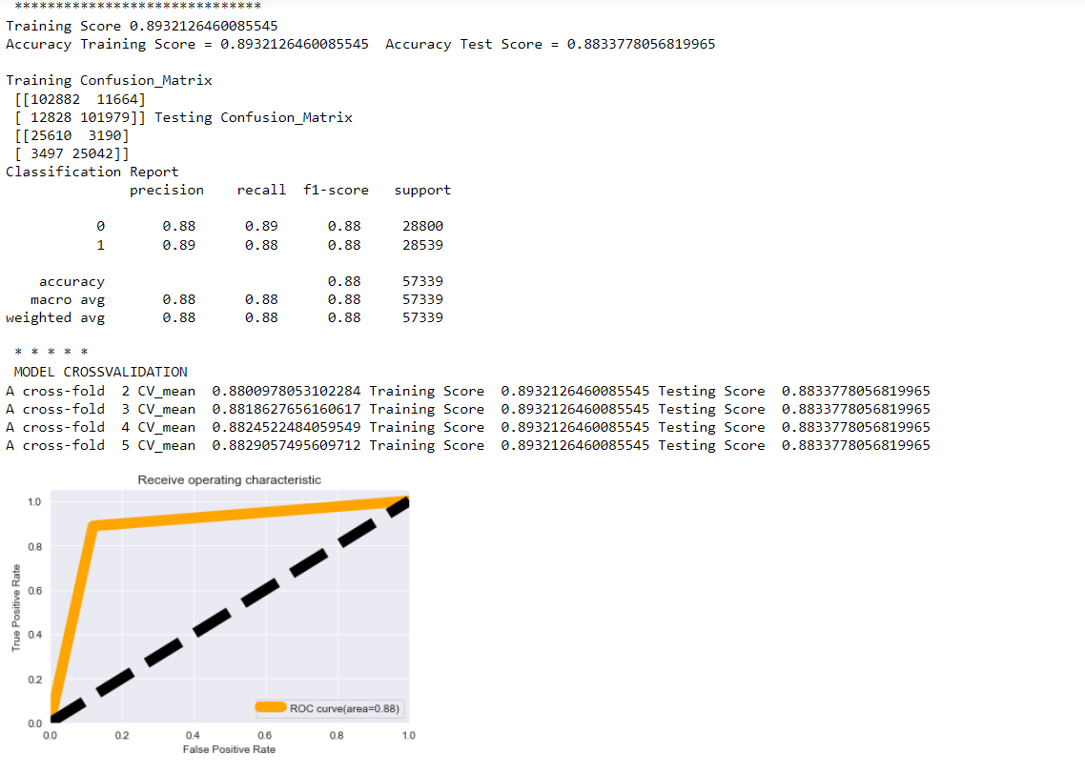
ALGORITHMS I HAVE USED IN MY PROJECT:
XG Boost

Slide 25
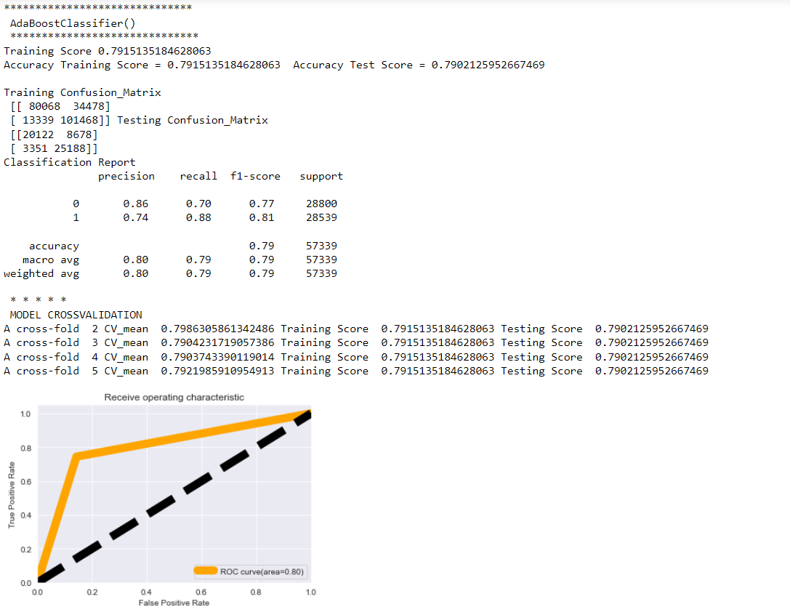
ALGORITHMS I HAVE USED IN MY PROJECT:
Ada Boost

Slide 26
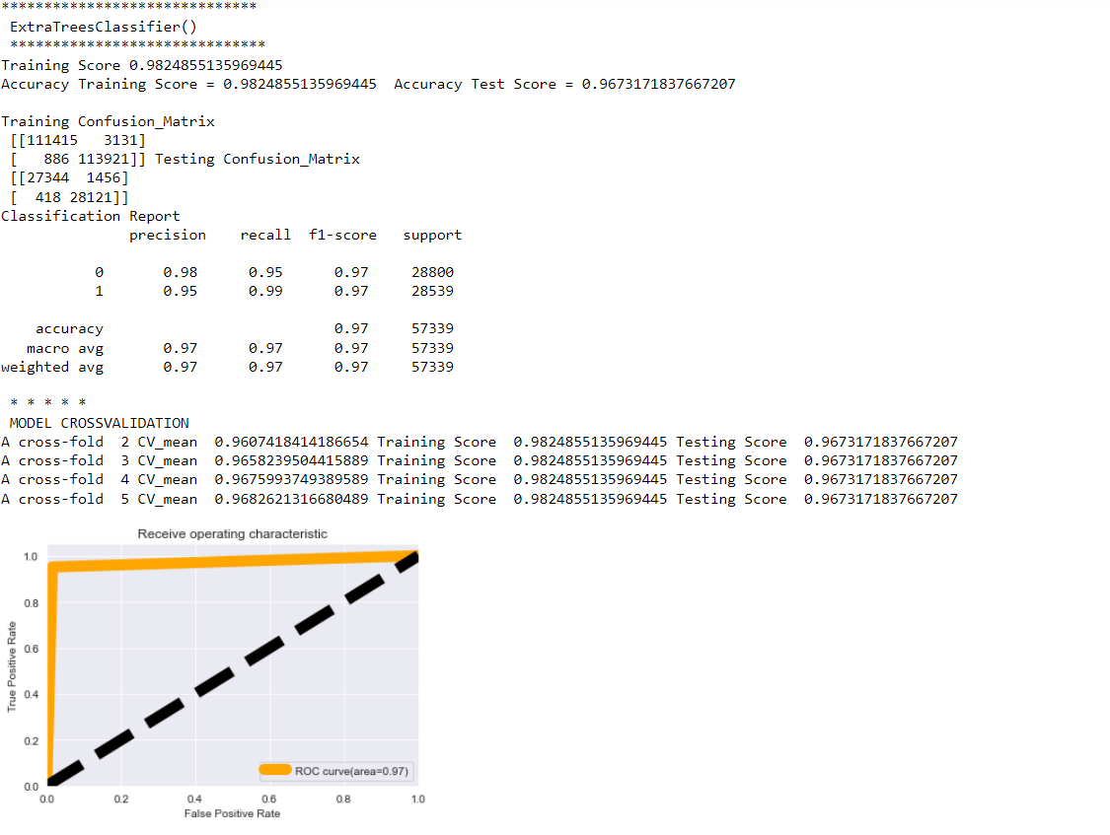
ALGORITHMS I HAVE USED IN MY PROJECT:
Extra Trees Classifier

Slide 27
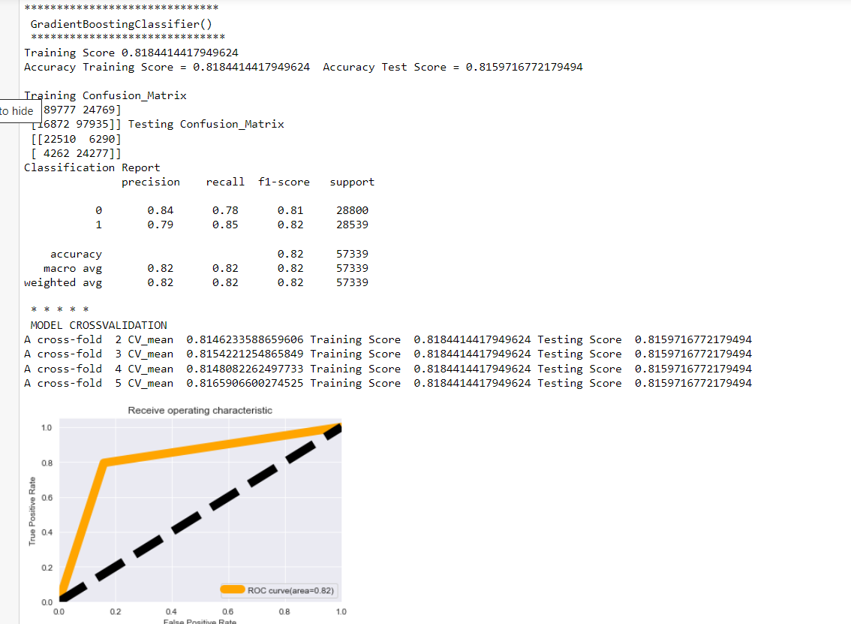
ALGORITHMS I HAVE USED IN MY PROJECT:
Gradient Boosting Classifier

Slide 28

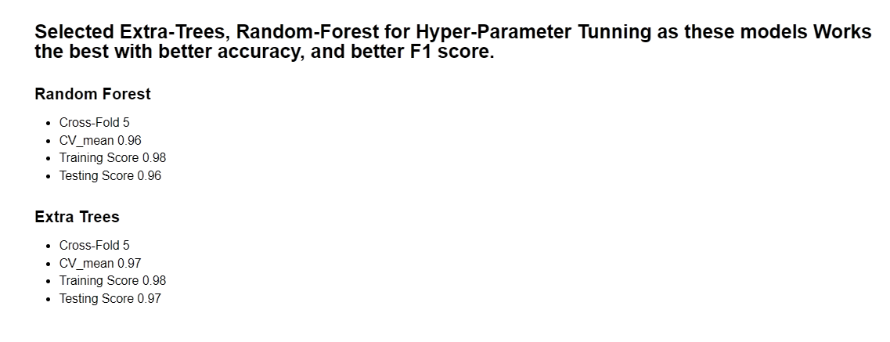
REGRESSION ALGORITHMS I HAVE USED IN MY PROJECT:
Extra Trees Regressor
Random Forest Regressor

Slide 29

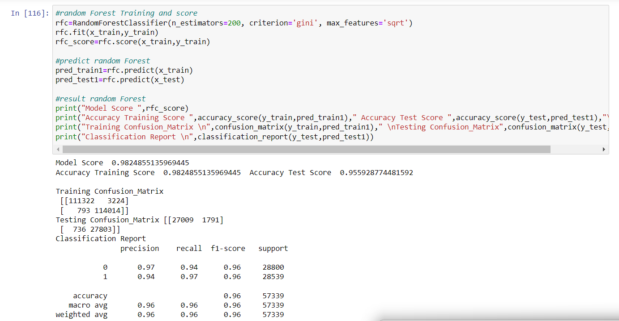
Using Hyperparameter
Random Forest

Slide 30

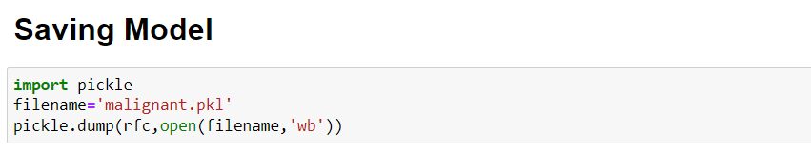
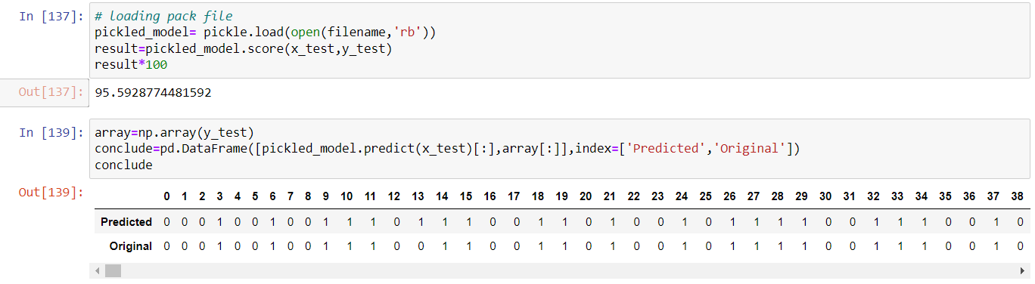
MODEL SAVING:
Model Loading Back:

Slide 31
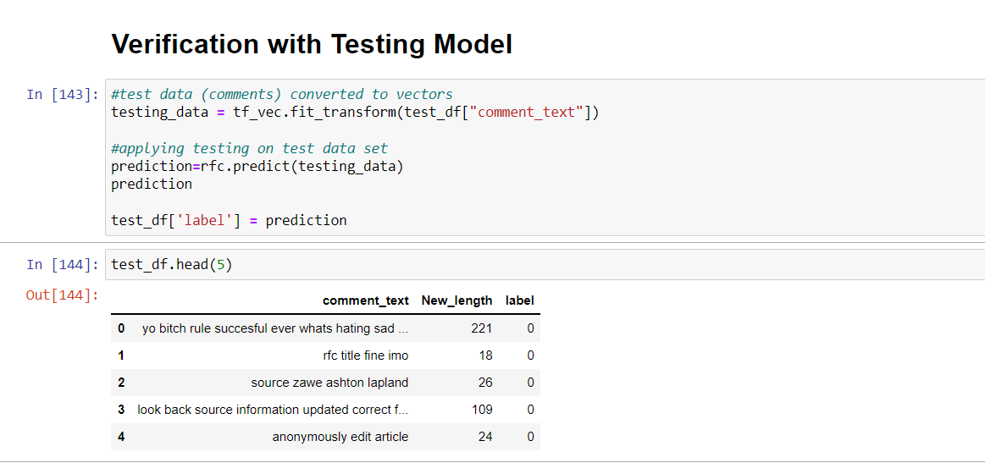
Prediction on Test Data SET SAVING:

Slide 32
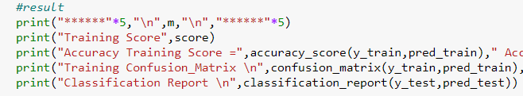
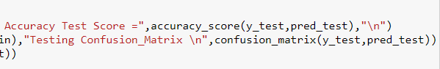
Conclusion:
In this project report, we have used machine learning algorithms for classification of Malignant Comment .
We have mentioned the step by step procedure to analyze of the dataset .
Thus we can select the features which are not correlated to each other and are independent in nature.
We calculated the performance of each model using different performance metrics and compared them based on these metrics.
There were large no. of feature present in our dataset, I analyzed the data and dropped all the necessary features.
From overall analysis and visualization I come into conclusion that , the feature that most effect the sales price of a cars are:

Slide 33

Final Conclusion
I hope this model will help companies to classify the malignant and non malignant comments in social media.
To conclude, the application of machine learning in malignant comment classification is still at an early stage. I hope this study has moved a small step ahead in providing some methodological and empirical basis contributions.
I think and hope that this will help social media platform and to be more user Friendly.

Slide 34

Thankyou

